Slide 1
increase monthly active users
Desired Outcome
Opportunities
make me engage into a pet community
make me feel convenient
make me feel credible and professional
reward me for loyalty
create in-app discussion forums
hold local pet events
design reordering checkout process
design easy-to-navigate interface
give detailed product information
content
offer subscription discount
Page design
Page design
Rent a field
Logic design
show customer reviews
content
recognize their feature stories
User experience
Offer food
develop AI-powered recommendation
Page design
content
UX
Page design
create social interaction features
Offer awards
Engage staff
provide random acts of kindness
clarify pricing system
content
Design rules
Web design
AI algorithm
Page design
introduce “Cutest Pet Photo of the Month" challenges
Engage staff to support
UX
Page design
create professional partnership
Pay for partnership
provide in-app consultation
early access to new products
Page design
User experience
get expert endorsements
Hire experts
Problem frame up is in the next slide
celebrate anniversaries
Ads

Slide 2
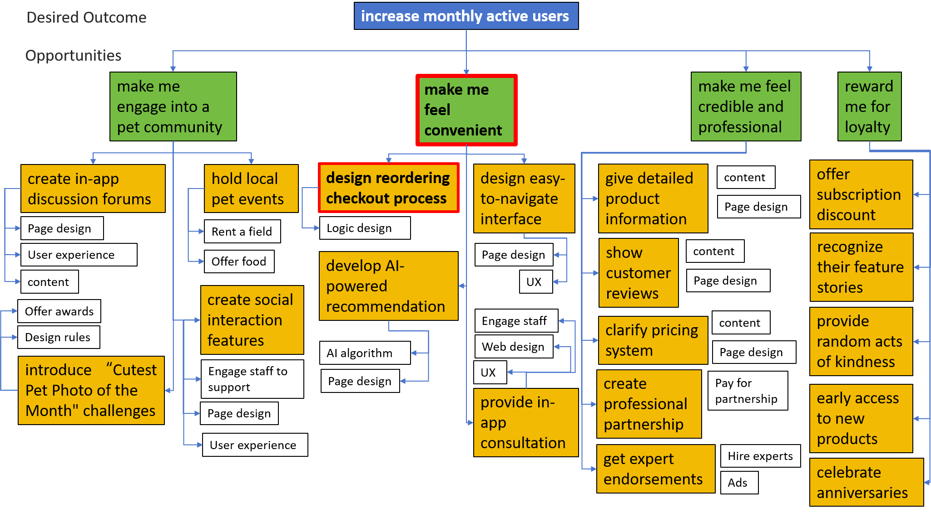
The problem of making users feel convenient is the priority as it’s the core feature that solving users’ problems and making profits directly. Compared with it, others are more intangible for a long term contribution though the solutions to the problem of making users feel credible seems more easy to do.
Solutions in this problem are more achievable, and I prefer first designing the reordering checkout process. For its function, it enables users to repeat the same operations as the last time which is super useful in pet service like showering and trimming fur. For its cost, all can be done in software level and will not involve too much members.

Slide 3
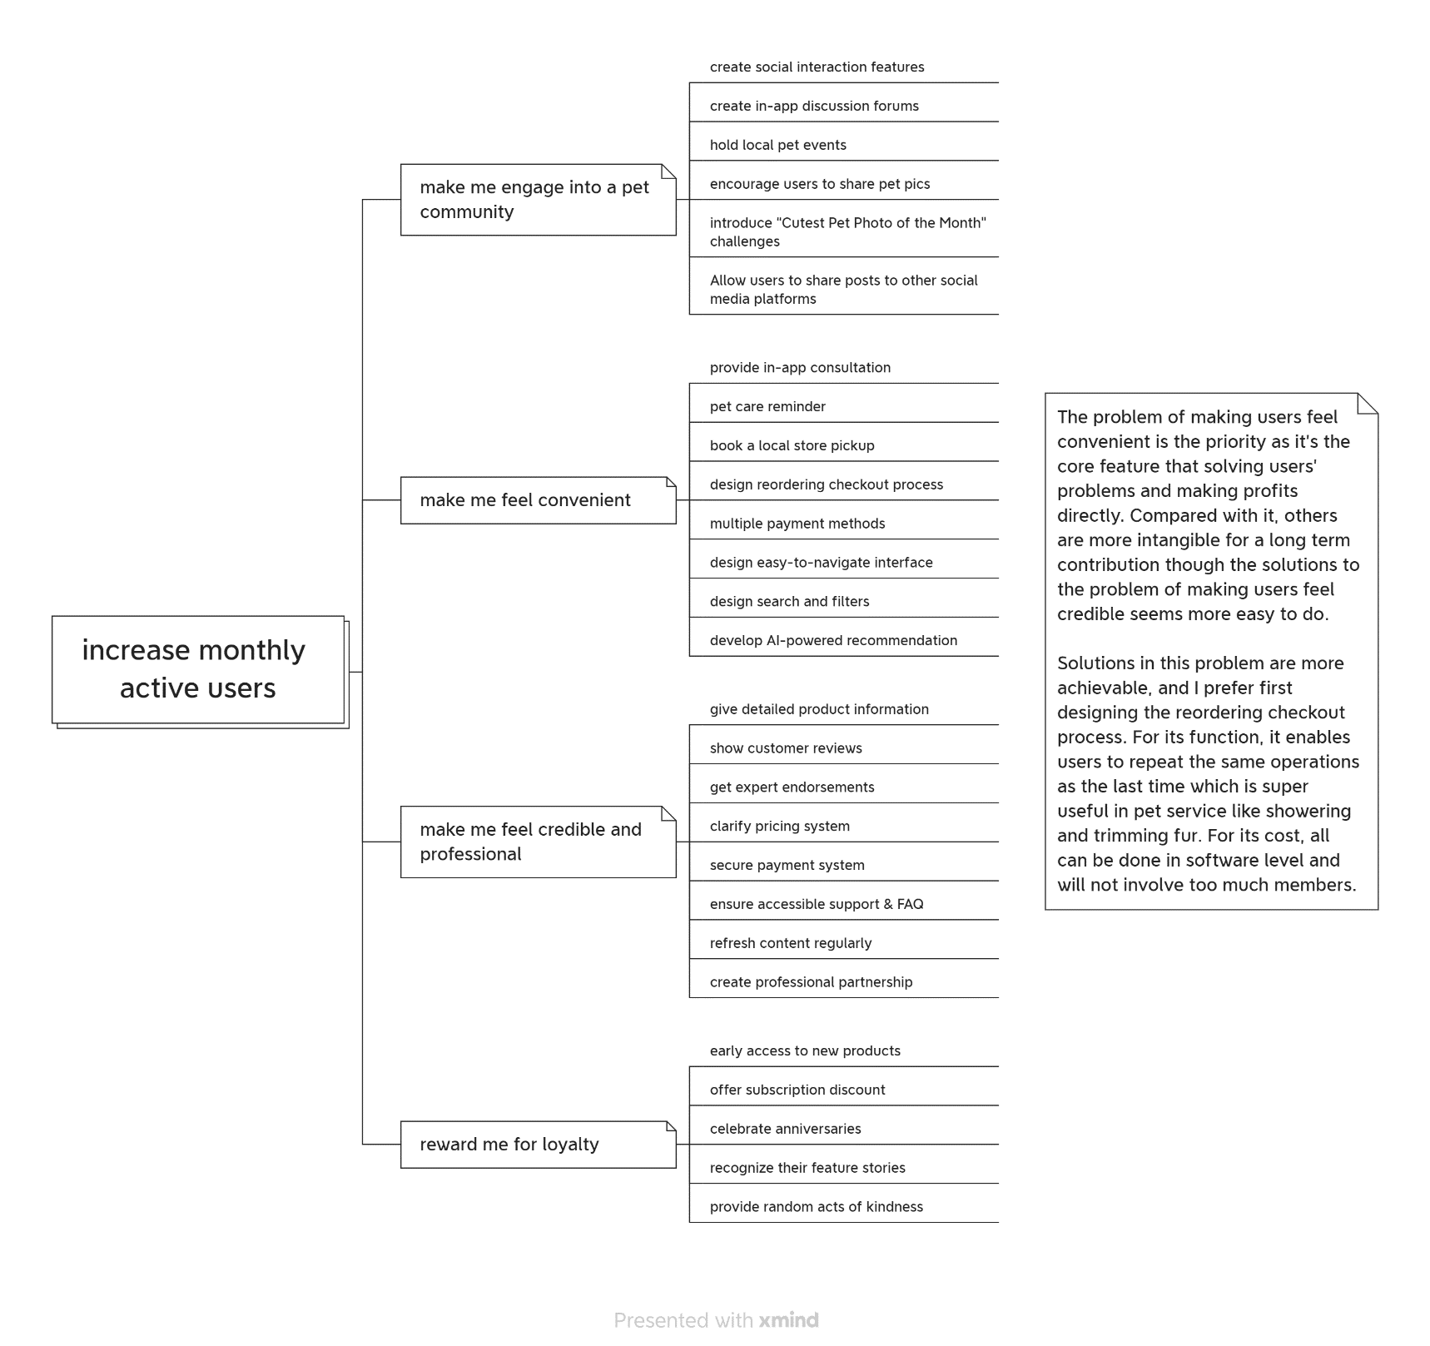
Due to the layout of PowerPoint, I remove some solutions in every opportunities to fit the page and add experiments.
My complete OST without experiments part is attached as an image here.

